Slide 1
SPRING VALLEY VILLAGE POLICE DEPARTMENT
MONTHLY NEWSLETTER:
DECEMBER 2023
1025 CAMPBELL ROAD
HOUSTON, TX 77055
PHONE: 713-465-8323
COMMUNITY MATTERS.
WE ARE A TEAM.

Slide 2
INTRODUCTION
Hilshire Village Residents,
Traditionally, the holiday season is a festive time of year. It is also a time when people are busy and become vulnerable to theft and other holiday crime. We will continue our patrols in an effort to keep thieves out of the area.
Please be sure to properly secure your homes at all times. Even if you plan to be away only a few minutes, make sure to secure windows, doors, and remember to set your alarms. If you plan on leaving town for a couple of days or longer, please call the Spring Valley Village Police Department to be placed on the House Watch List.
Remember, while out shopping to always; think about where you are and check the area to see who may be watching (especially when at the ATM). Double check your vehicle to ensure it is locked, and upon returning to your car quickly enter your car, lock the doors and make sure that everything is still there.
Best wishes for a Merry Christmas and a magnificent New Year.
Sincerely,
Chief M. Schulze
1025 CAMPBELL ROAD, HOUSTON, TX 77055
PHONE: 713-465-8323 / EMAIL: DISPATCH@SPRINGVALLEYTX.COM

Slide 3
DECEMBER 2023
DATE | DAY | SPECIAL DAYS FOR THIS MONTH
DECEMBER 07, 2023 | THURSDAY | PEARL HARBOR REMEMBRANCE DAY
DECEMBER 21, 2023 | THURSDAY | FIRST DAY OF WINTER (DECEMBER SOLSTICE)
DECEMBER 24, 2023 | SUNDAY | CHRISTMAS EVE
DECEMBER 25, 2023 | MONDAY | CHRISTMAS DAY
DECEMBER 31, 2024 | SUNDAY | NEW YEAR’S EVE
COMMUNITY MATTERS.
WE ARE A TEAM.
1025 CAMPBELL ROAD, HOUSTON, TX 77055 / PHONE: 713-465-8323 / EMAIL: DISPATCH@SPRINGVALLEYTX.COM

Slide 4
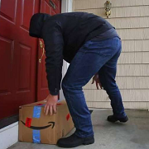
Public Service Announcements (PSA) From Our Officers
December is the month for increased delivery of packages. Thieves “Porch Pirates” are aware of this. When expecting deliveries, especially large packages, have family or friends secure them out of sight. Let’s watch out for each other during this holiday season.
Corporal F. McClain
Be aware of distraction crimes. If approached by someone representing a utility company, make sure you observe or ask for credentials. If you did not call the utility company do not allow anyone in your home to check for water or gas leaks. Thieves will attempt to distract in order to enter your home for the purpose of theft. If you feel uncertain, call the Spring Valley Village Police Dept. Try to obtain an accurate description of the person and vehicle.
Sergeant C. Spriggs
Establish the 9 p.m. routine: Each evening conduct a security check and verify that vehicles, residence, garages, gates, and backyard sheds are locked. Activate exterior lights, security cameras, and alarm systems. Remove all valuables from your vehicle.
Officer R. Moore
COMMUNITY MATTERS.
WE ARE A TEAM
1025 CAMPBELL ROAD, HOUSTON, TX 77055 / PHONE: 713-465-8323 / EMAIL: DISPATCH@SPRINGVALLEYTX.COM

Slide 5
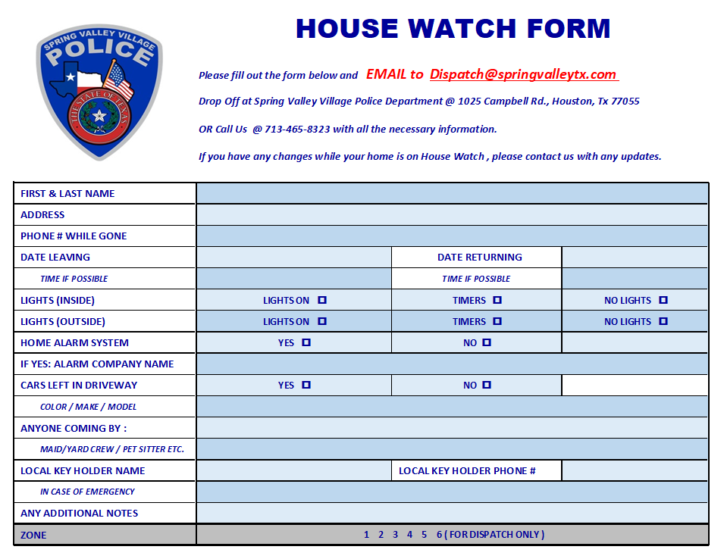
TIPS TO PREP BEFORE LEAVING
Close windows, blinds, curtains, shutters, lock all doors and garage.
Set timers on interior lights. This goes a long way in deterring burglars, who often look for crimes of opportunity.
Set your thermostat accordingly, for unnecessary energy cost, but can also help avoid unforeseen problems with you HVAC equipment.
Take out the trash.
Run garbage disposal until clear.
Secure all valuables.
Lock all vehicles that are at home.
Turn on home security system.
Arrange for pets left at home.

Slide 6
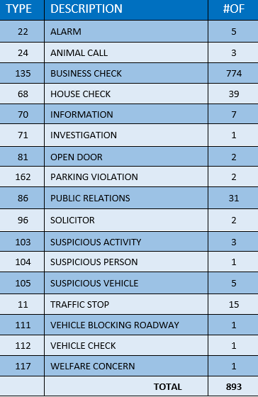
SPRING VALLEY POLICE DEPARTMENT
HILSHIRE VILLAGE
CALLS BY TYPE: 11/01/23 THRU 11/30/23
COMMUNITY MATTERS.
WE ARE A TEAM.
1025 CAMPBELL ROAD, HOUSTON, TX 77055
PHONE: 713-465-8323 / EMAIL: DISPATCH@SPRINGVALLEYTX.COM

Slide 7
IMPORTANT NUMBERS AT A GLANCE
EMERGENCY |  | NON - EMERGENCY
911 - FOR ALL EMERGENCY |  | 713-465-8323
988 – NATIONAL SUICIDE & MENTAL HEALTH
SPRING VALLEY VILLAGE |  | VILLAGE FIRE DEPARTMENT
SPRING VALLEY - CITY HALL | 713-465-8308 | VILLAGE FIRE DEPARTMENT |  | 713-465-2323
SPRING VALLEY - PD | 713-465-8323 | VFD - NON-EMERGENCY |  | 713-468-7941
SPRING VALLEY - PD FAX | 713-465-3135
SPRING VALLEY - COURT | 713-465-0333
HILSHIRE VILLAGE
HILSHIRE VILLAGE – CITY HALL | 713-973-1779
COMMUNITY MATTERS.
WE ARE A TEAM.
1025 CAMPBELL ROAD, HOUSTON, TX 77055 / PHONE: 713-465-8323 / EMAIL: DISPATCH@SPRINGVALLEYTX.COM

Slide 8
COMMUNITY MATTERS.
WE ARE A TEAM.
1025 CAMPBELL ROAD, HOUSTON, TX 77055
PHONE: 713-465-8323 / EMAIL: DISPATCH@SPRINGVALLEYTX.COM

